Slide 1



Report 3
View in Power BI
Last data refresh:
13/09/2024 04:36:49 UTC
Downloaded at:
06/11/2024 03:57:23 UTC

Slide 2
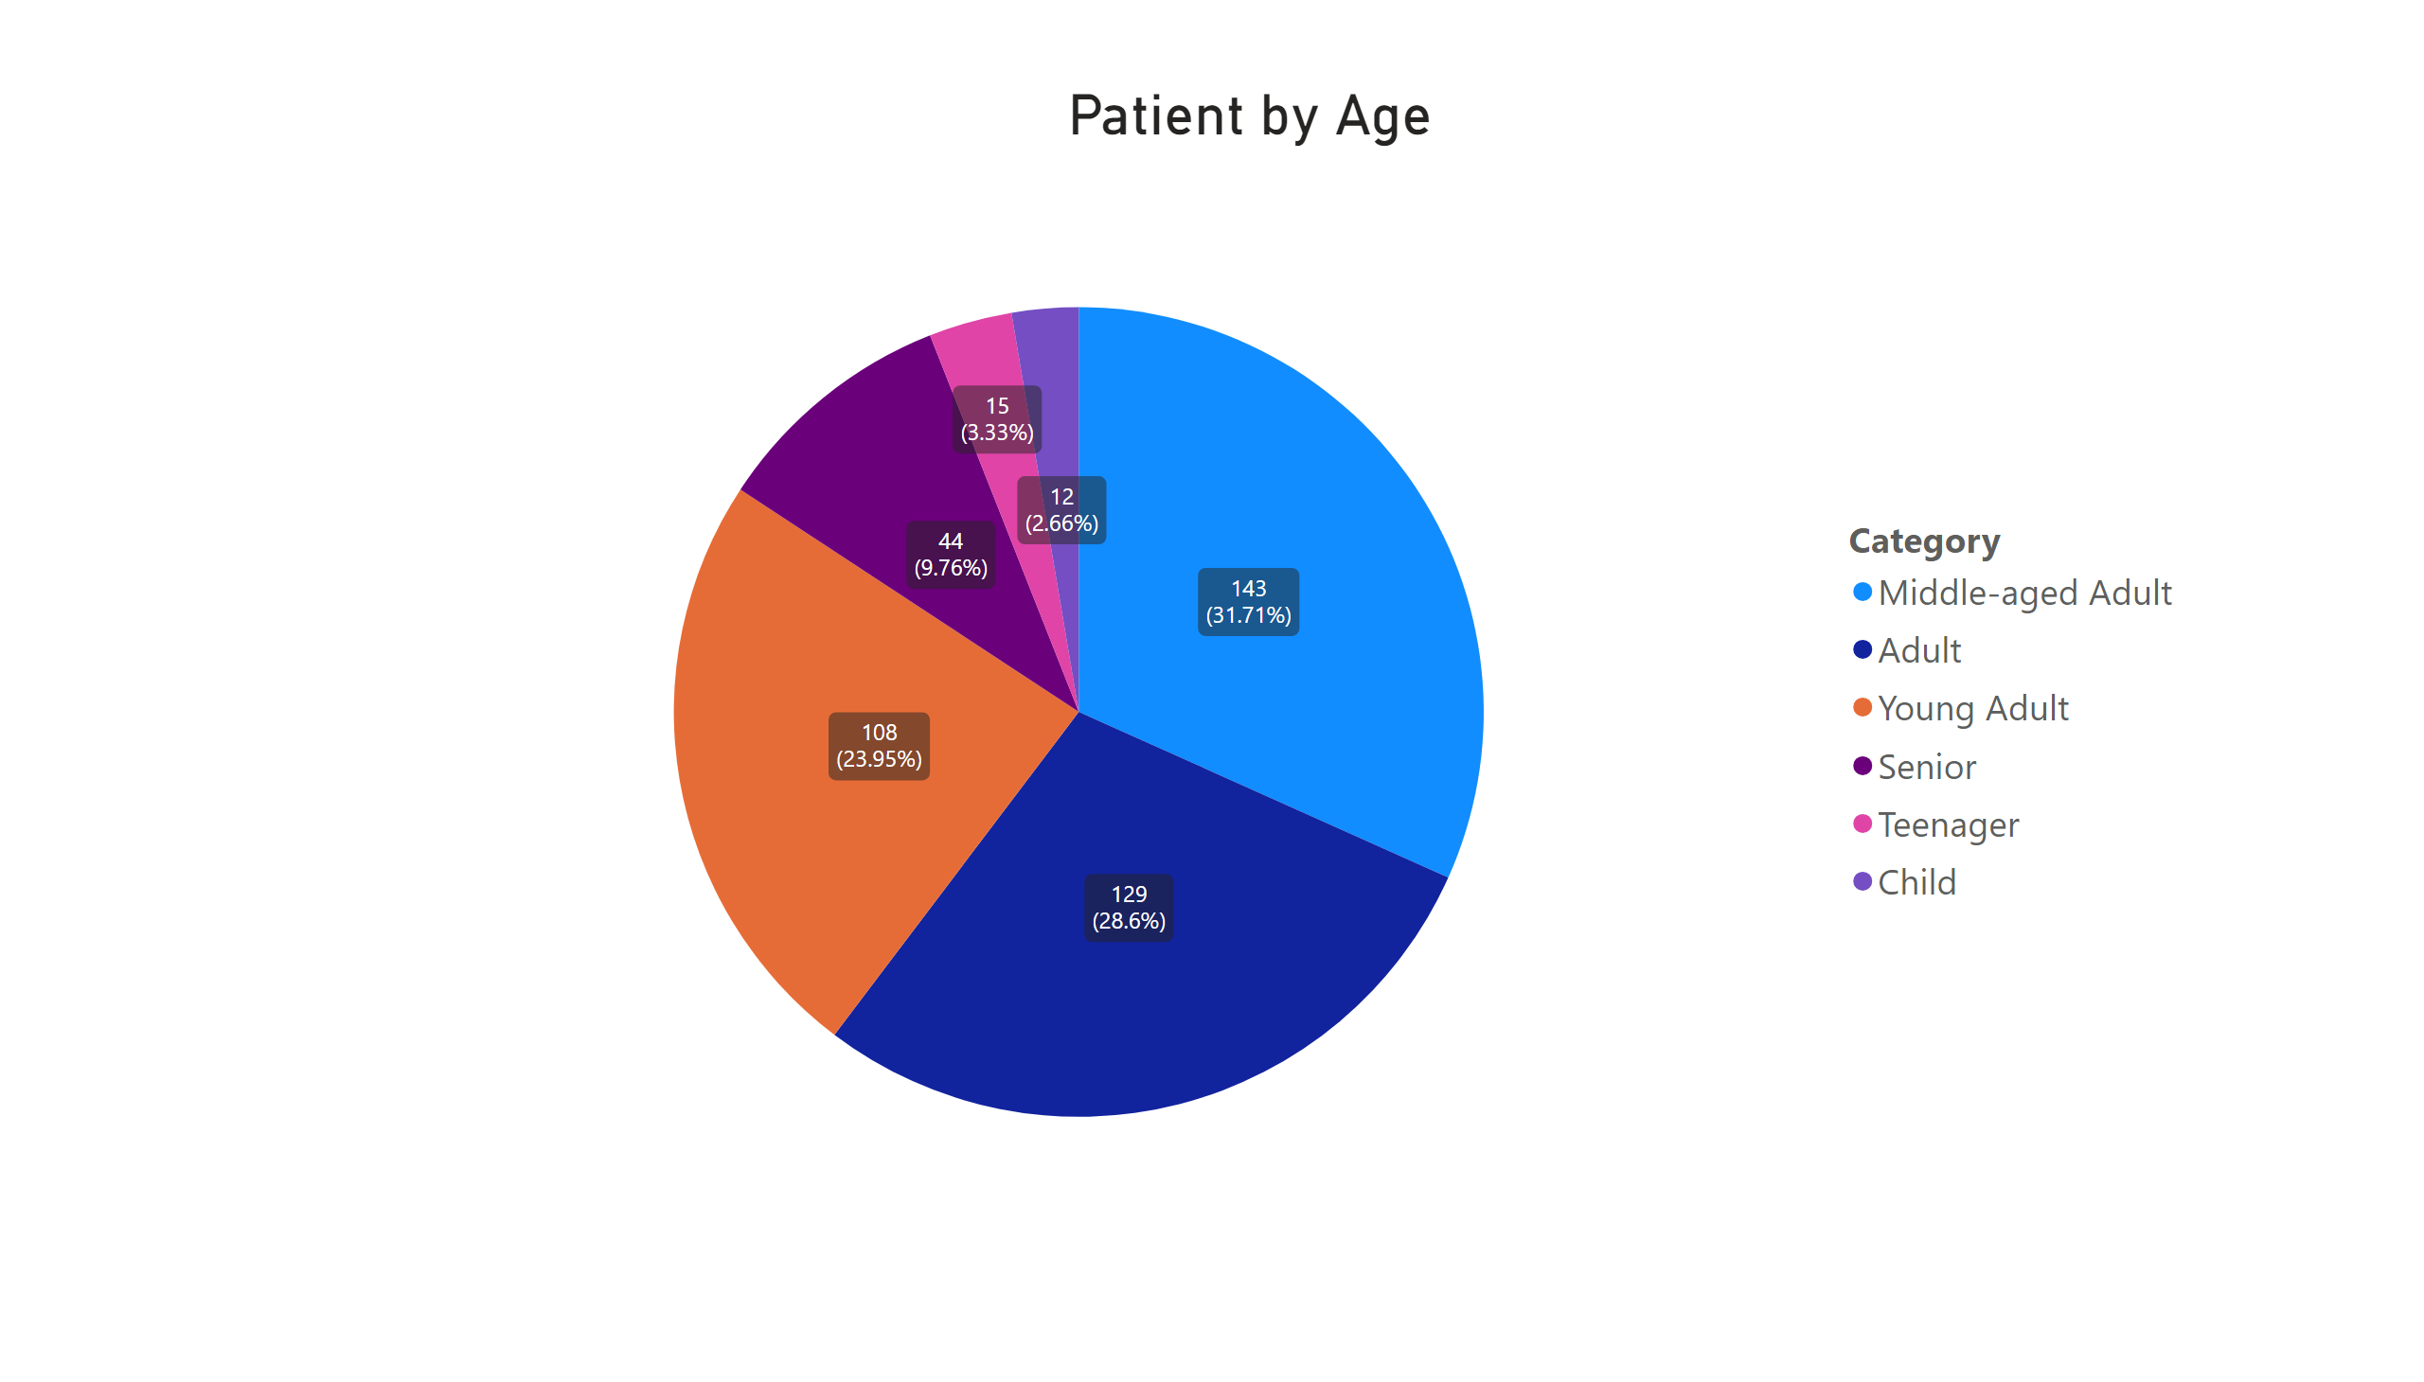
Page 1
Notes:
Patient by Age
No alt text provided

